Slide 1
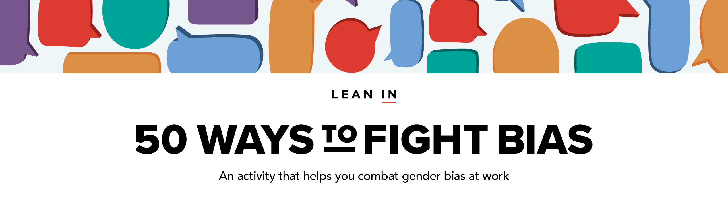
TO GET STARTED:
Download our Moderator Guide & Speaker Notes* to prepare for your session, find links to necessary handouts, and learn what to say.
ABOUT THE 50 WAYS PRESENTATION:
The 50 Ways to Fight Bias activity is divided into 4 different presentations.
Each presentation takes roughly 1–2 hours to complete and includes 12–13 different examples of gender bias in the workplace.
You can repeat this activity up to 4 times without repeating the same content.
This is PRESENTATION 1 of 4. For additional presentations, see the Moderator Guide & Speaker Notes.
* Use “Slide Show” mode to click on links in this presentation or right click to access the hyperlink when not in “Slide Show” mode.

Slide 3
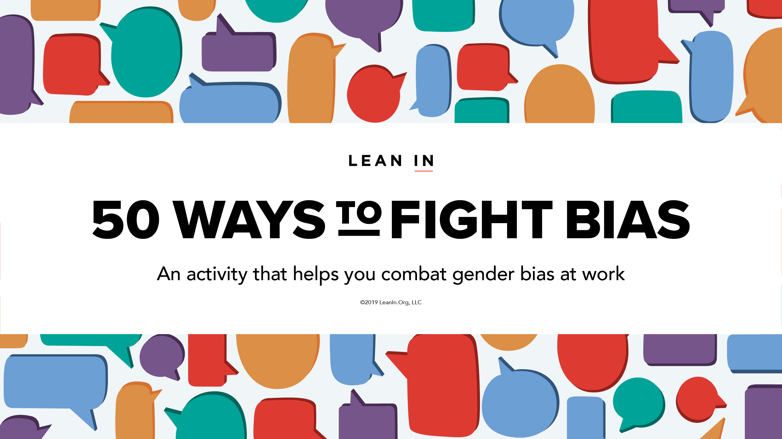

Slide 11
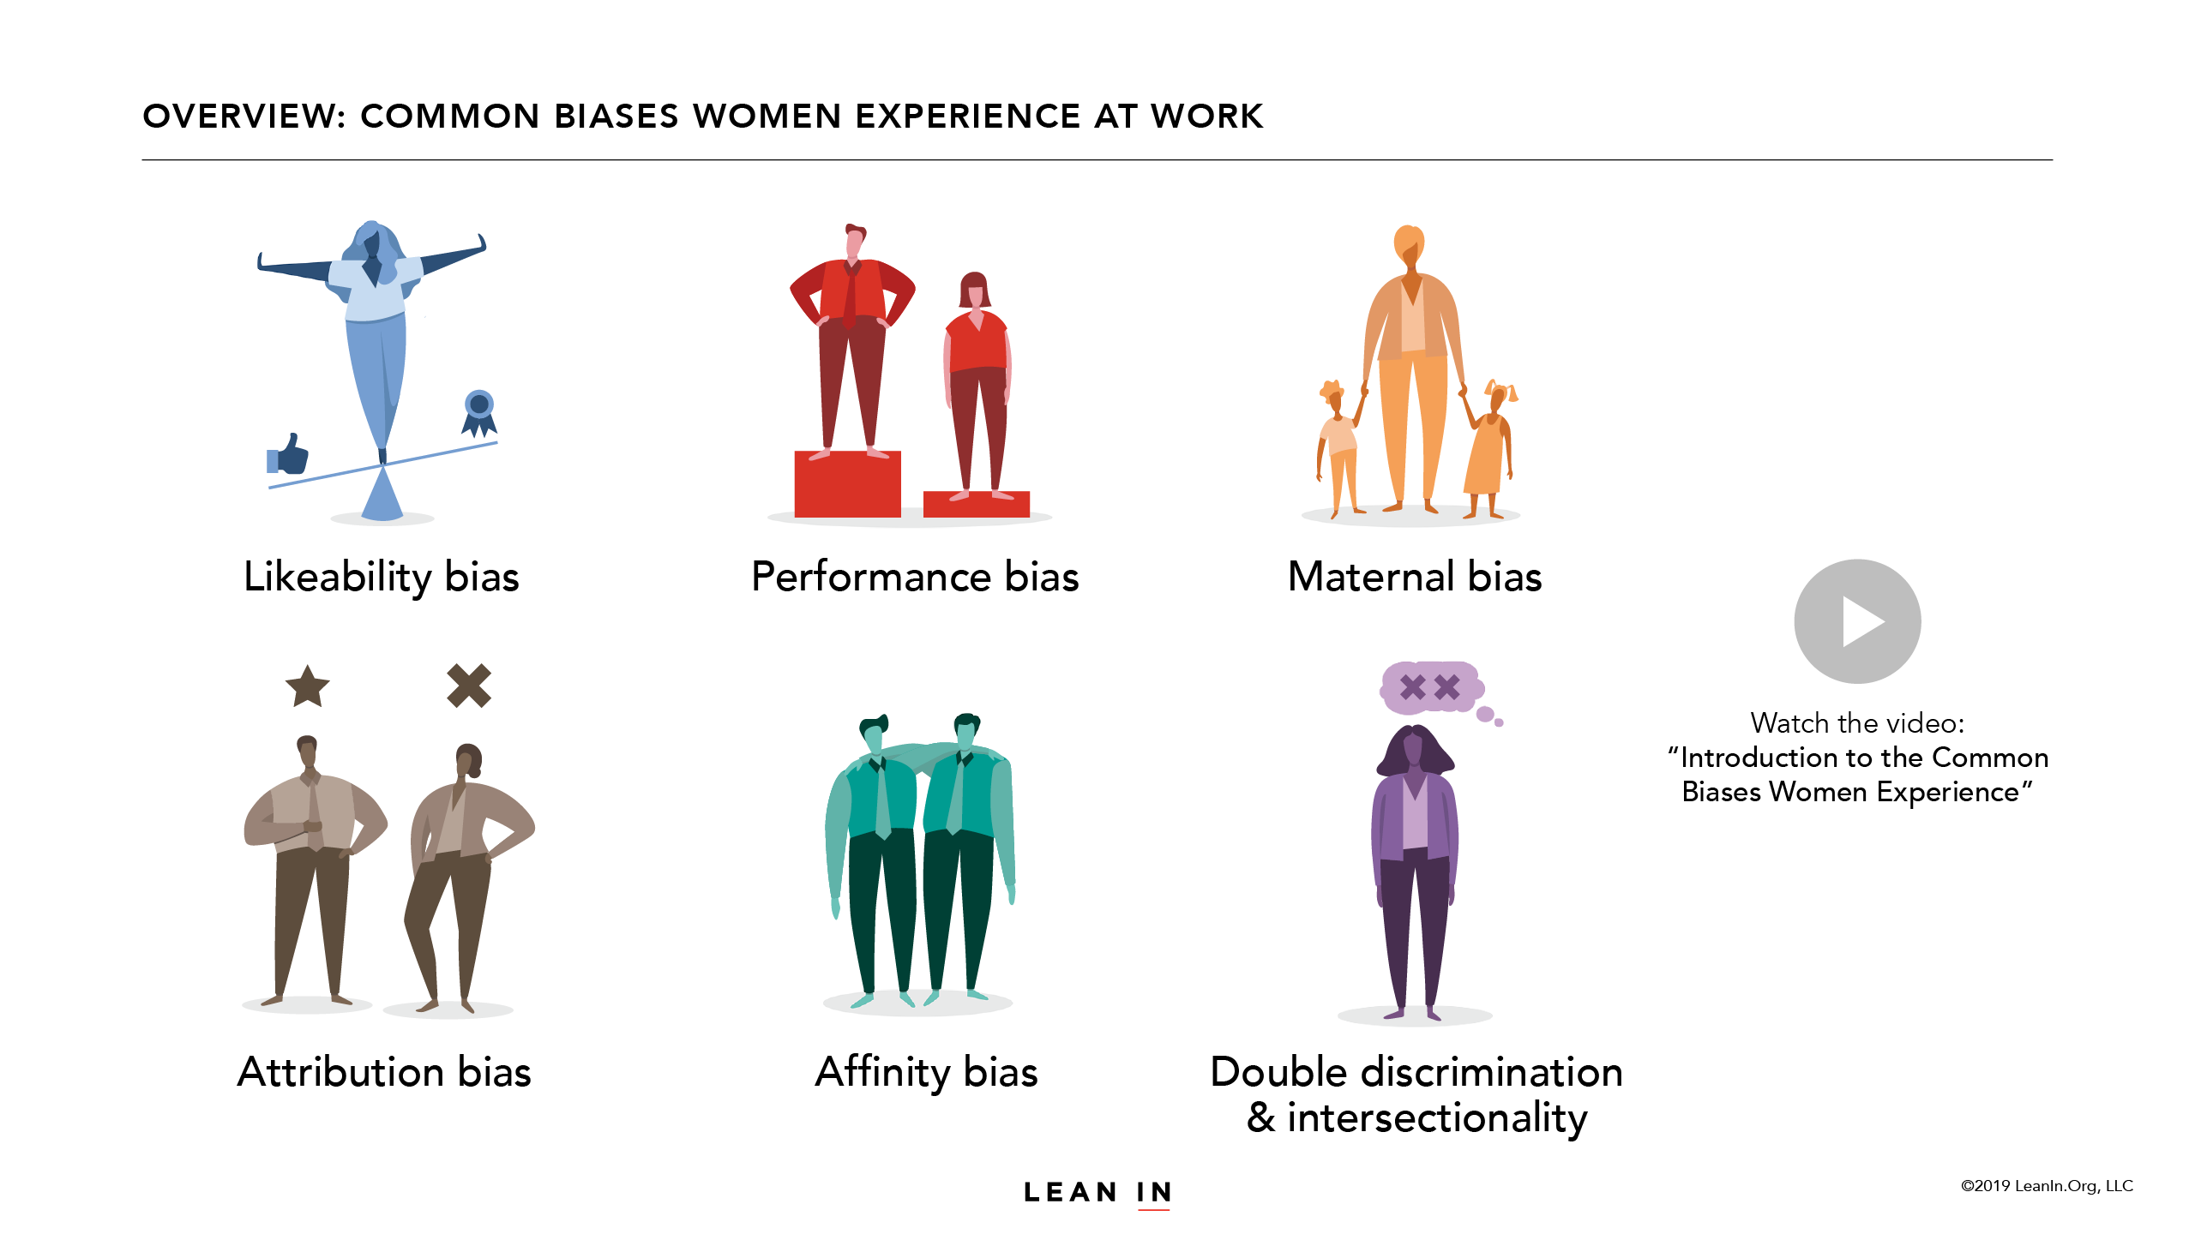
Watch the video: “Introduction to the Common Biases Women Experience”

Slide 20
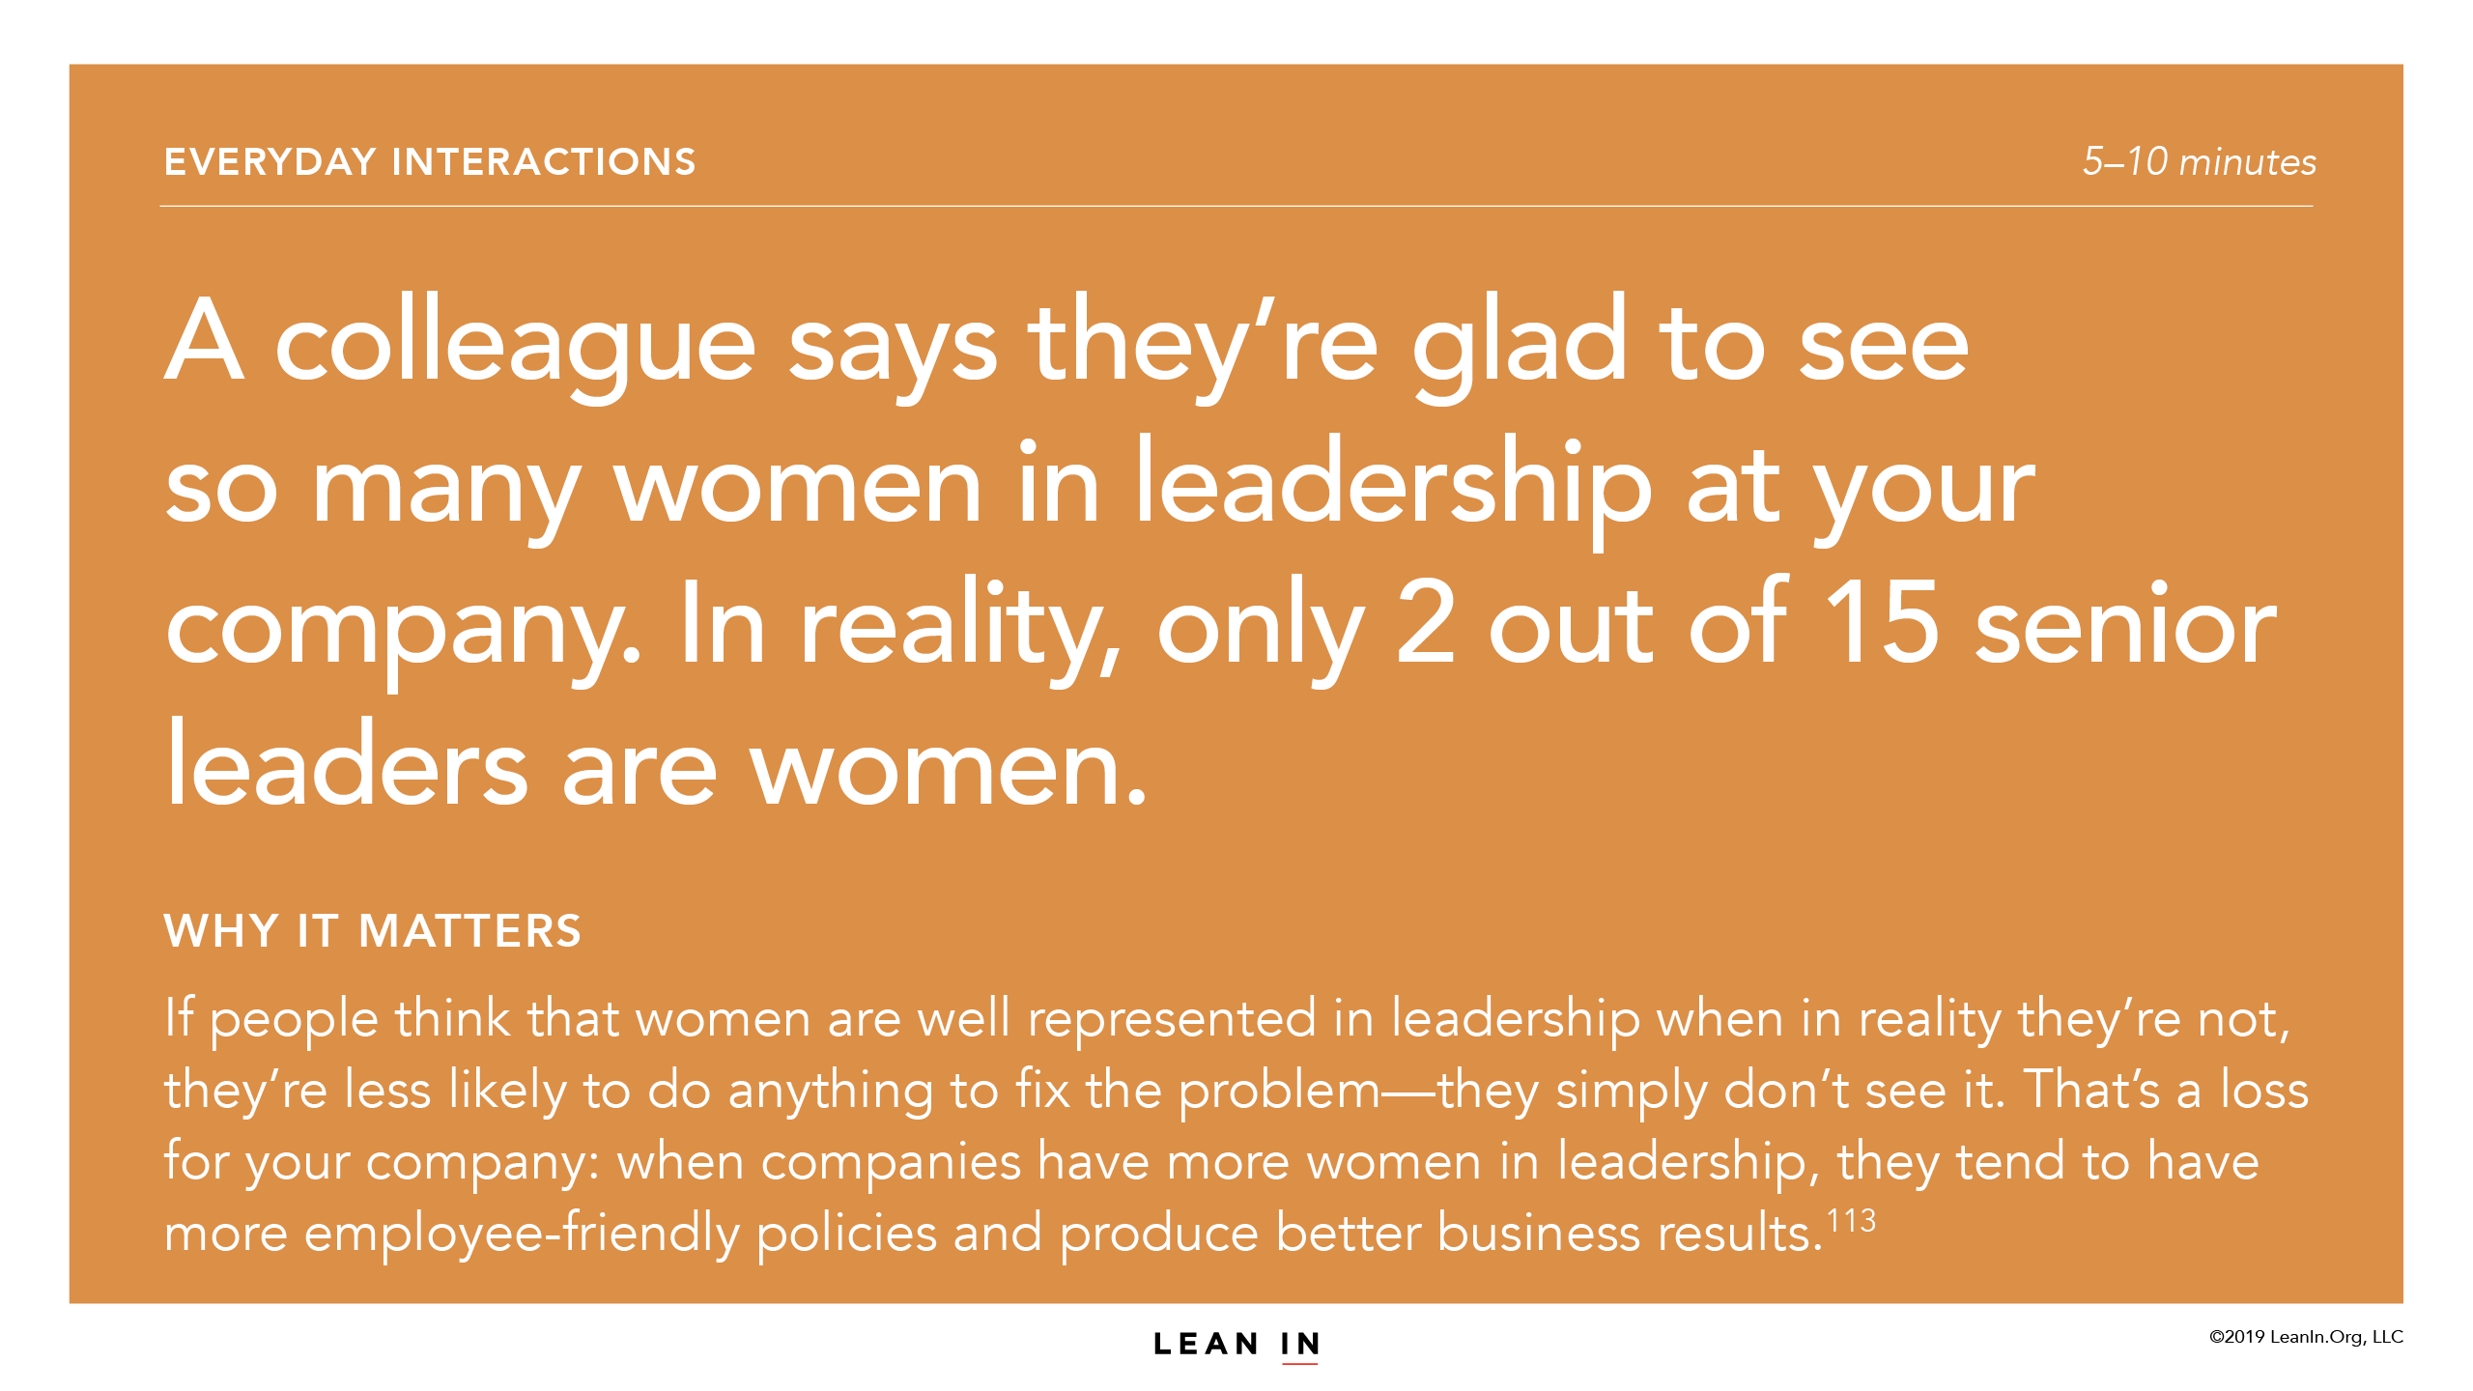

Slide 22
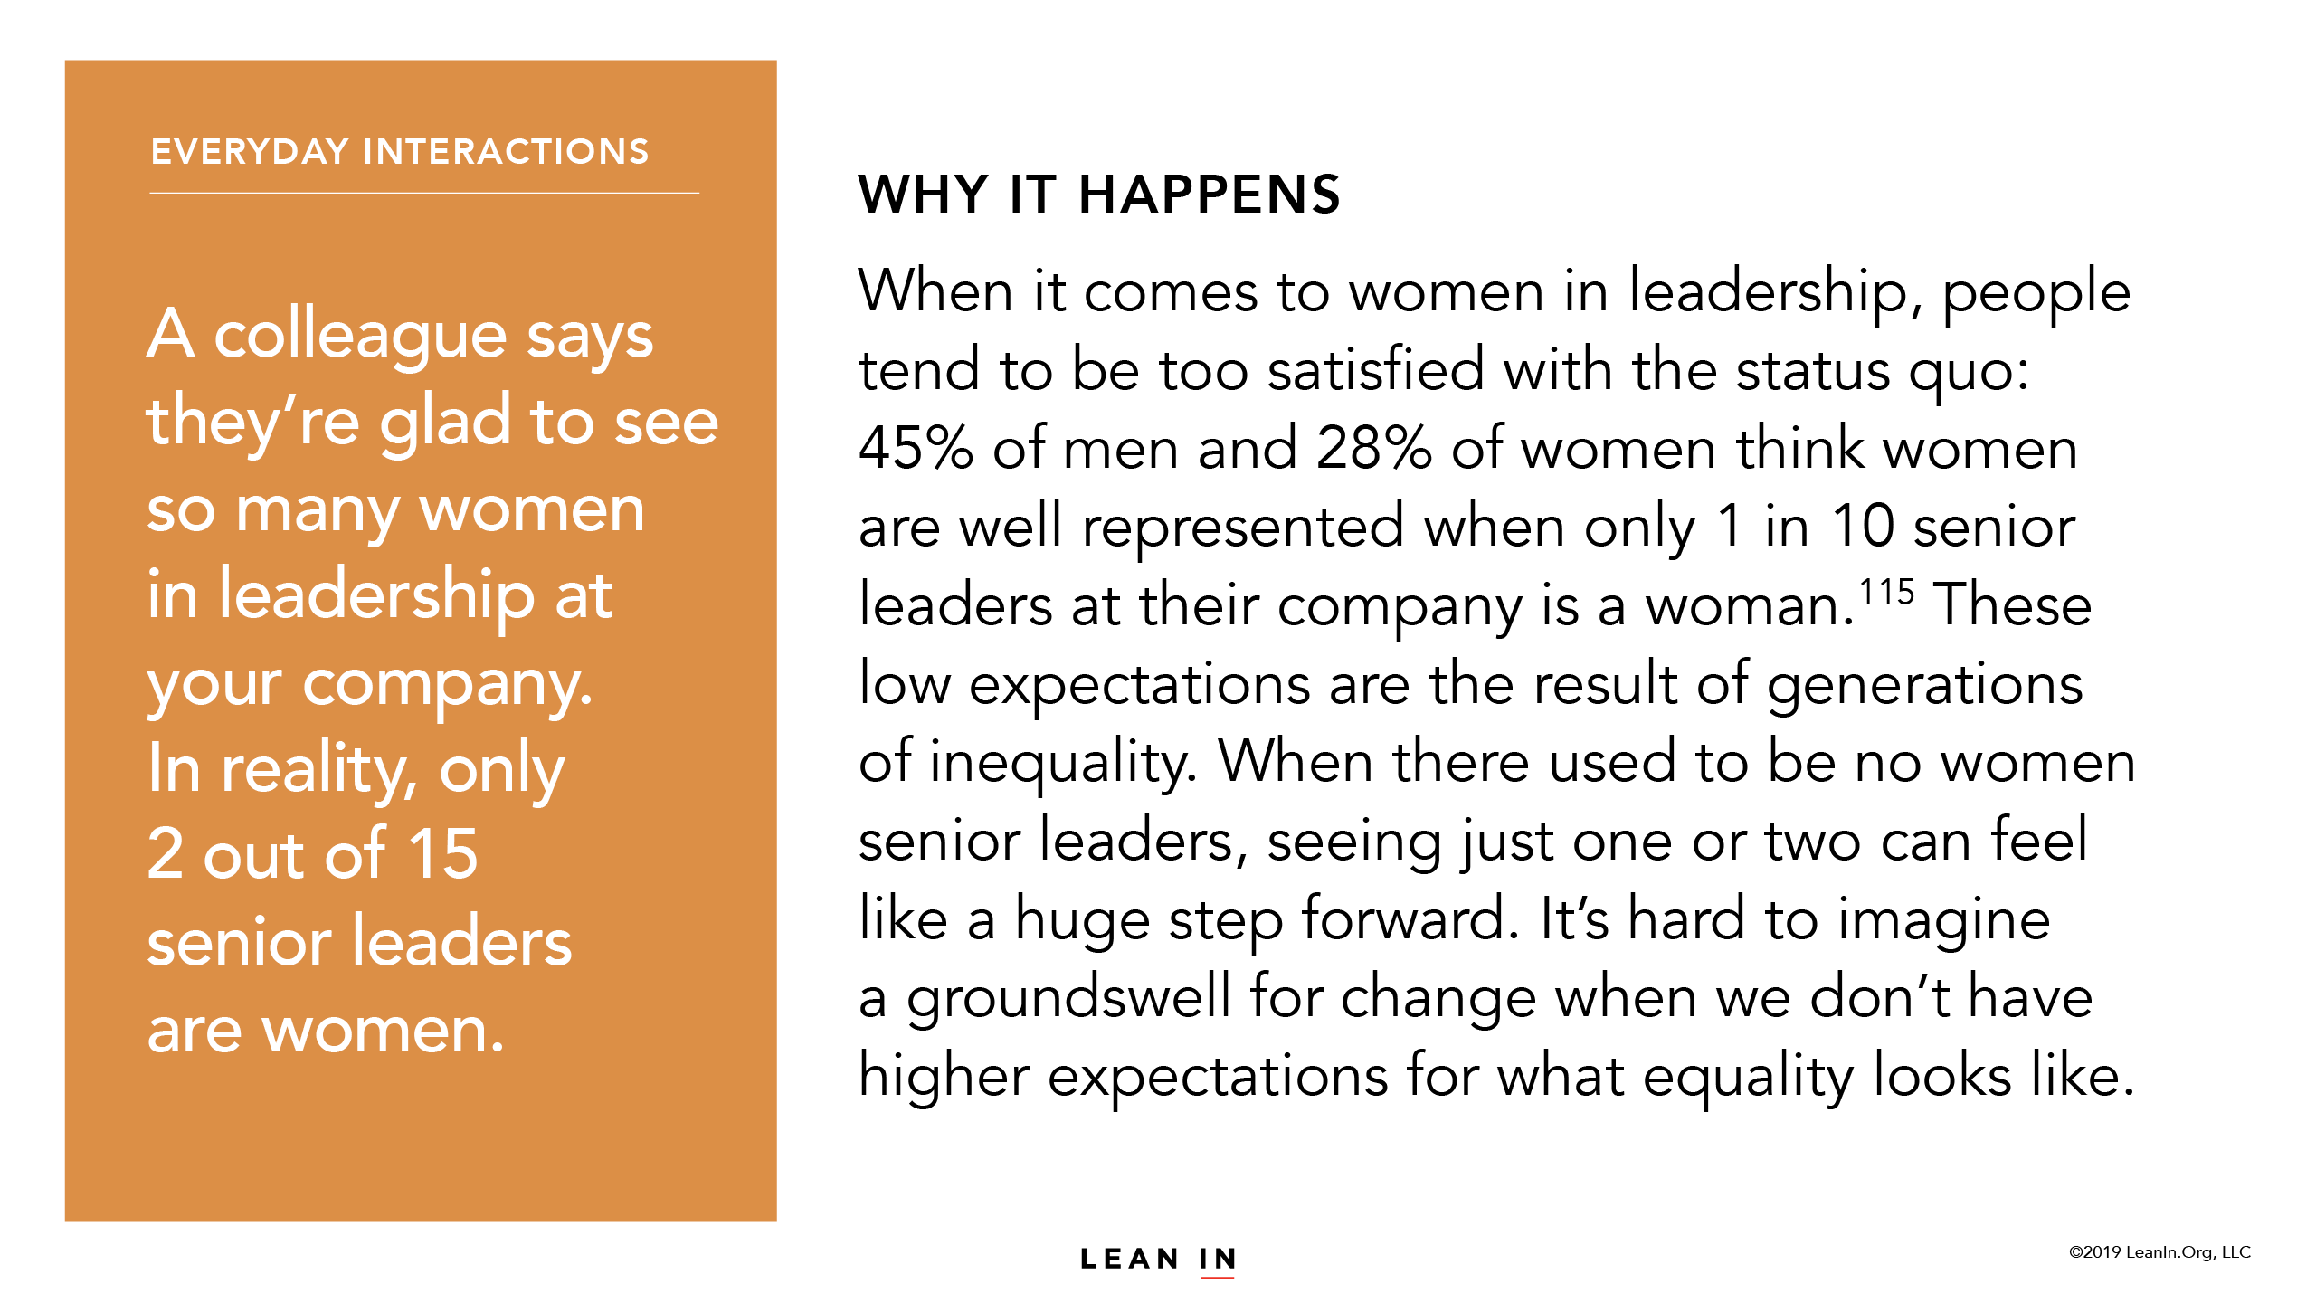

Slide 25
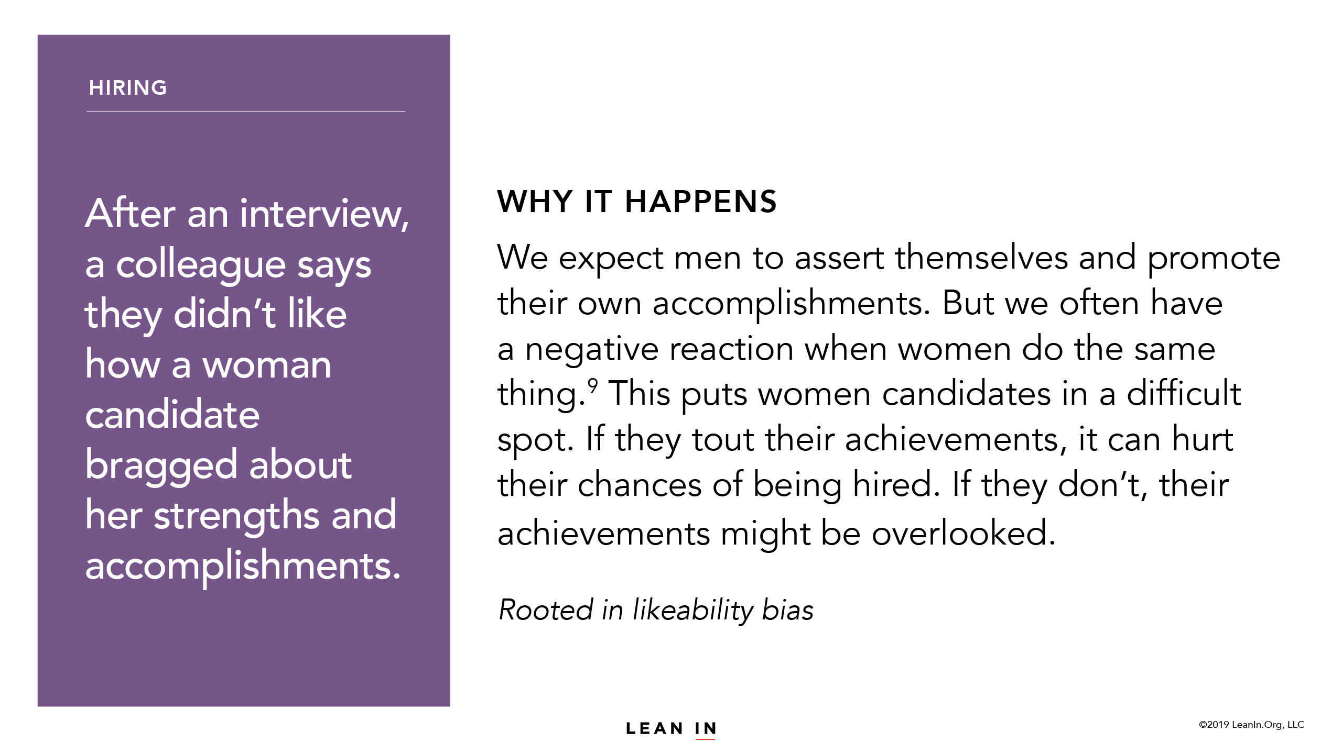

Slide 26
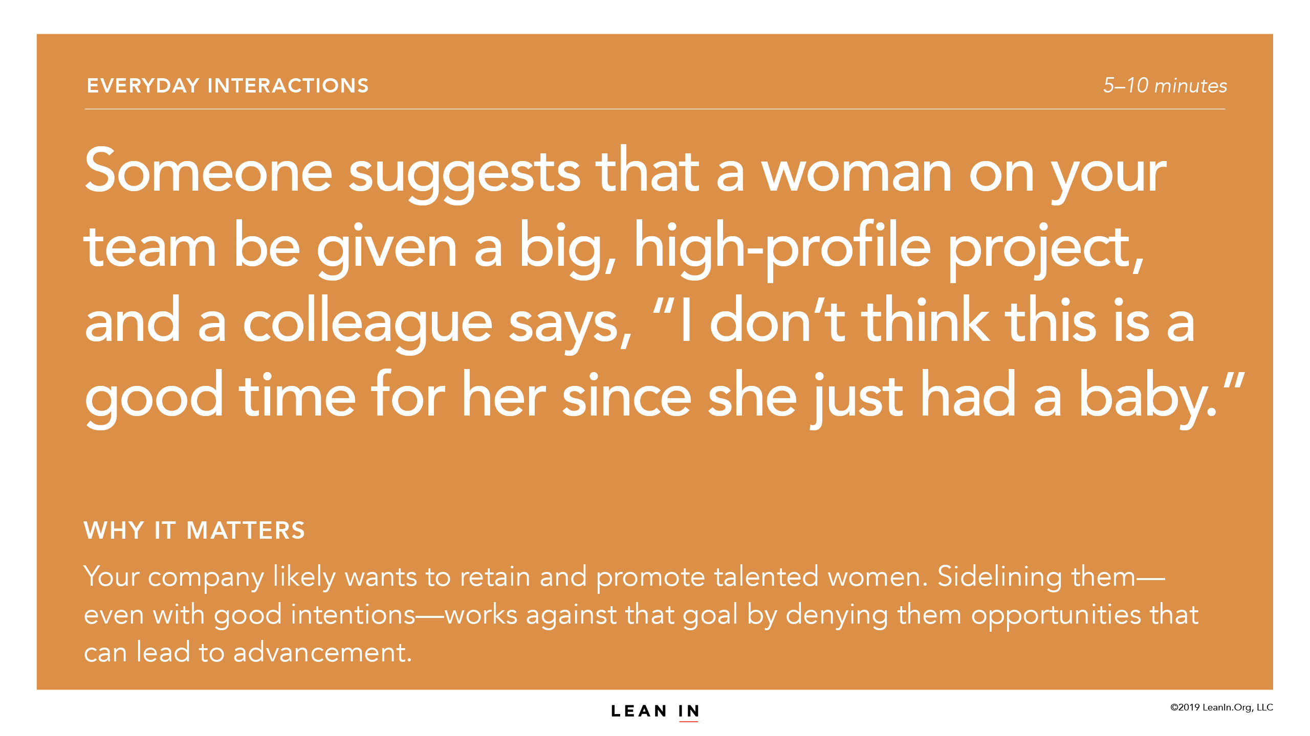

Slide 31
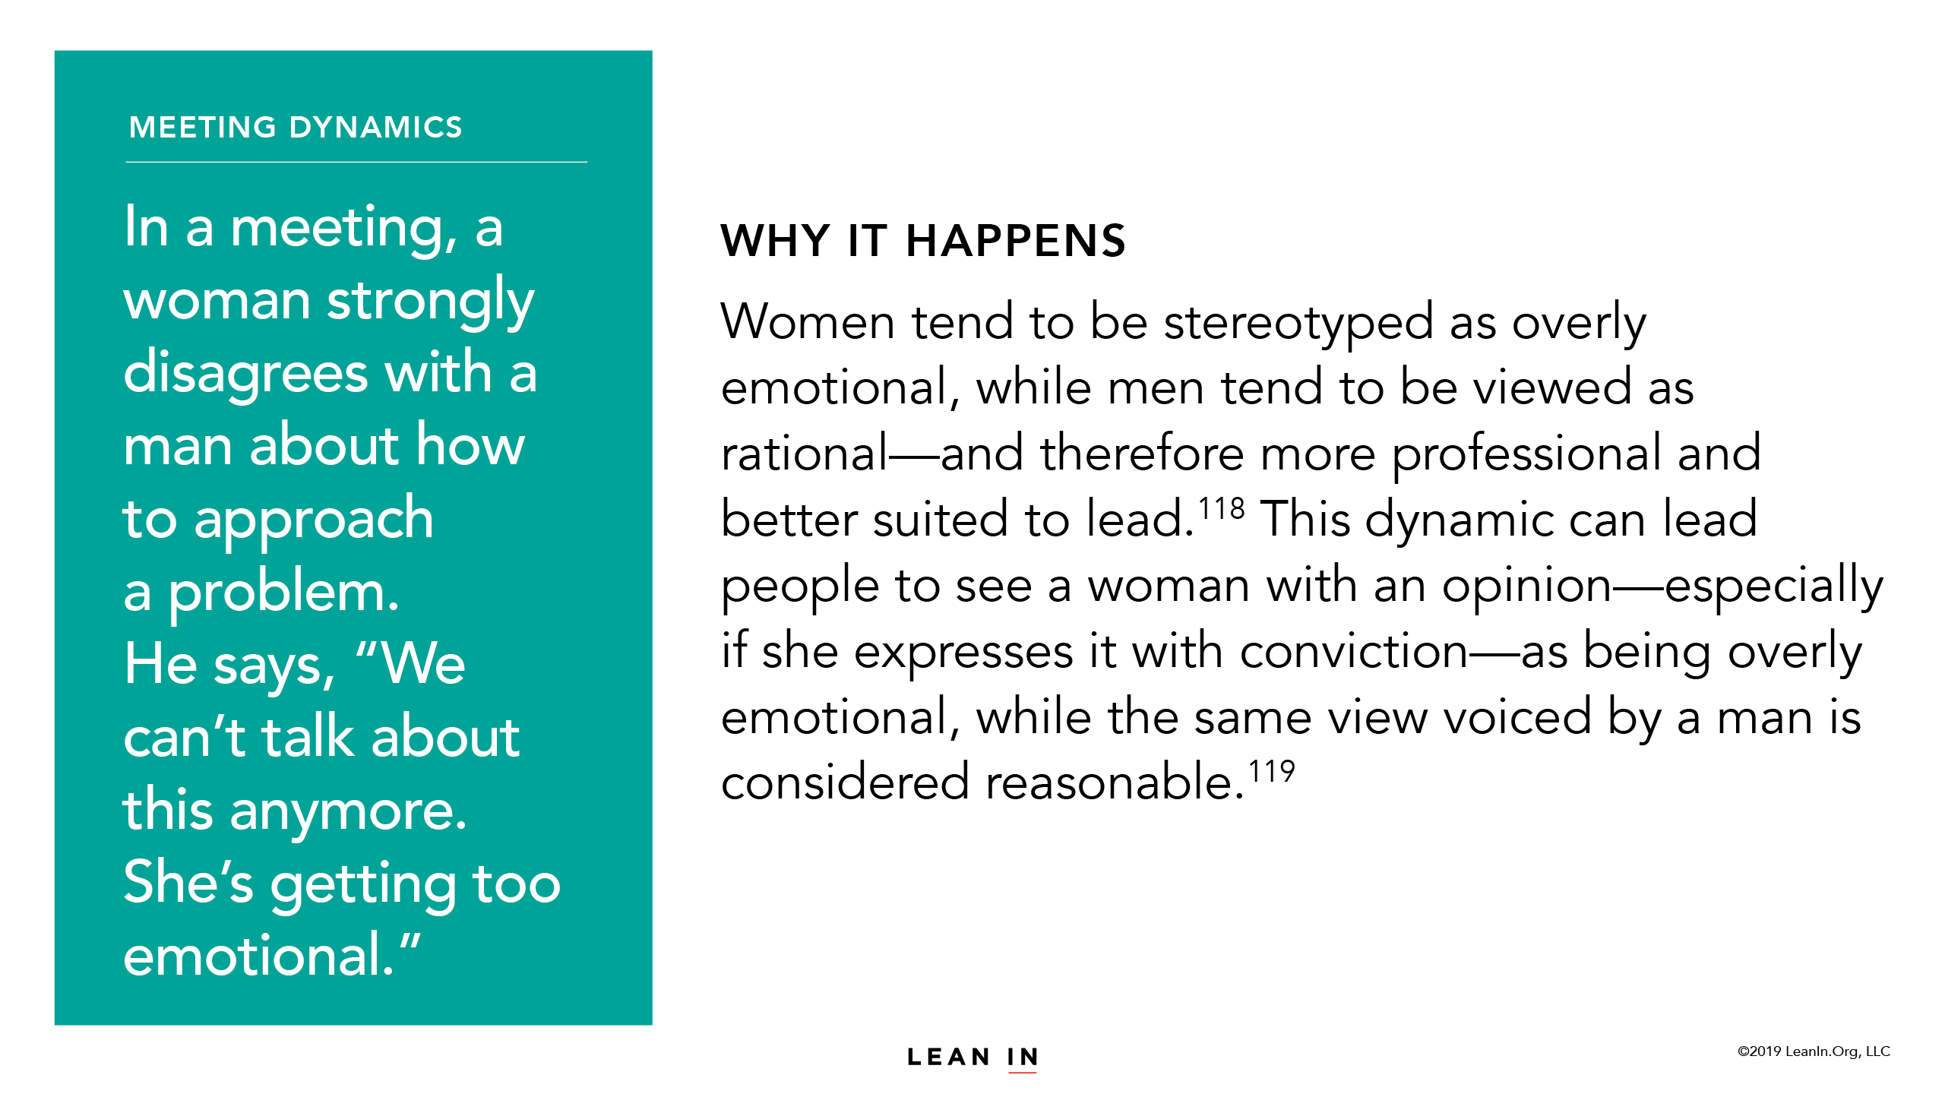

Slide 34
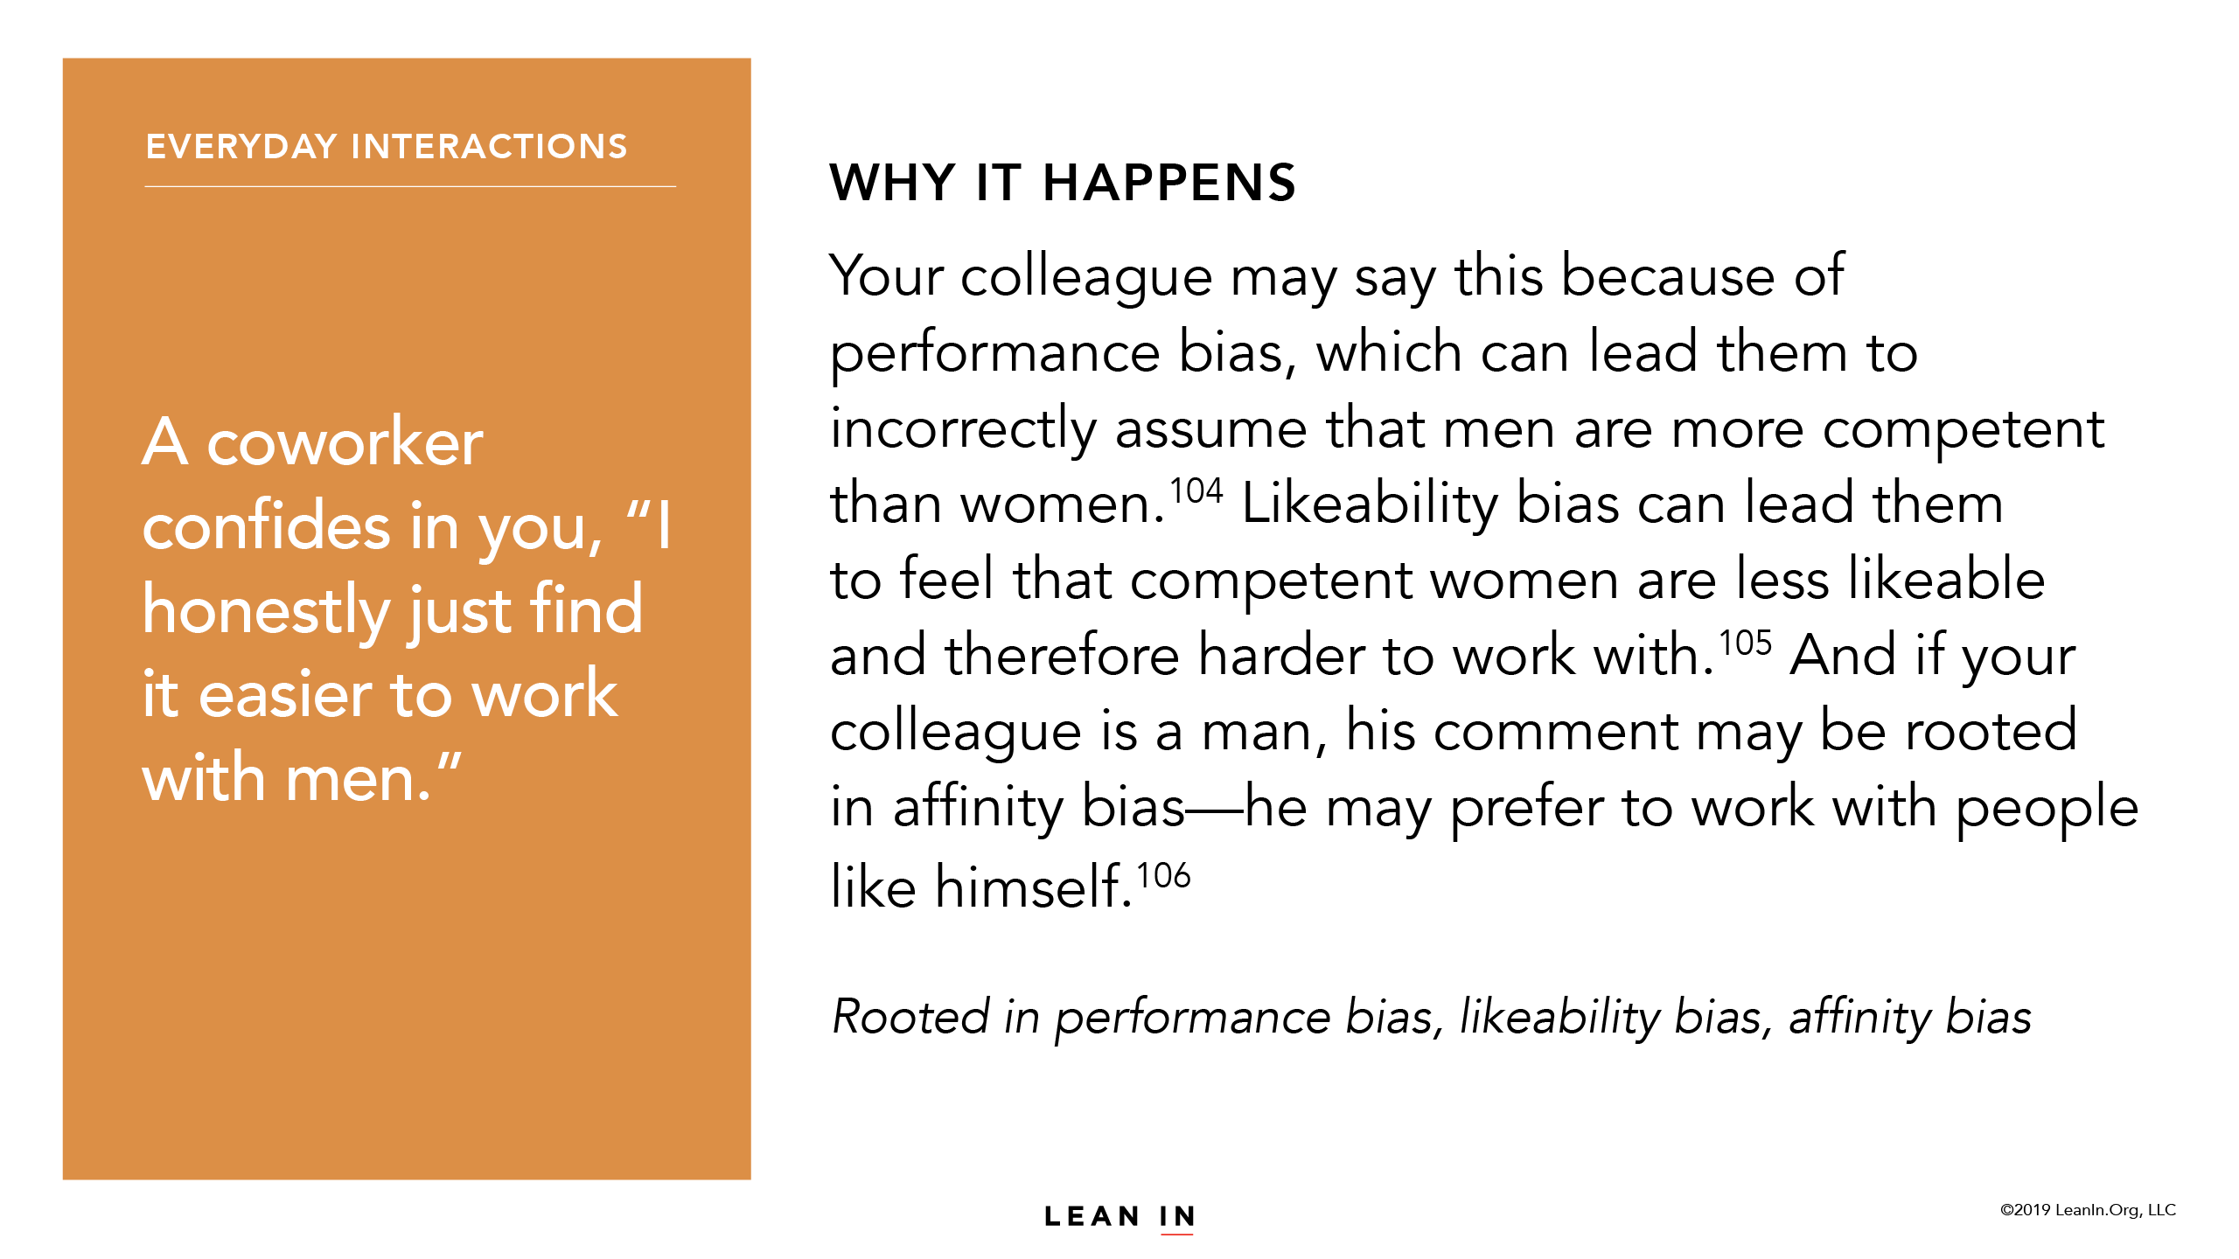

Slide 41
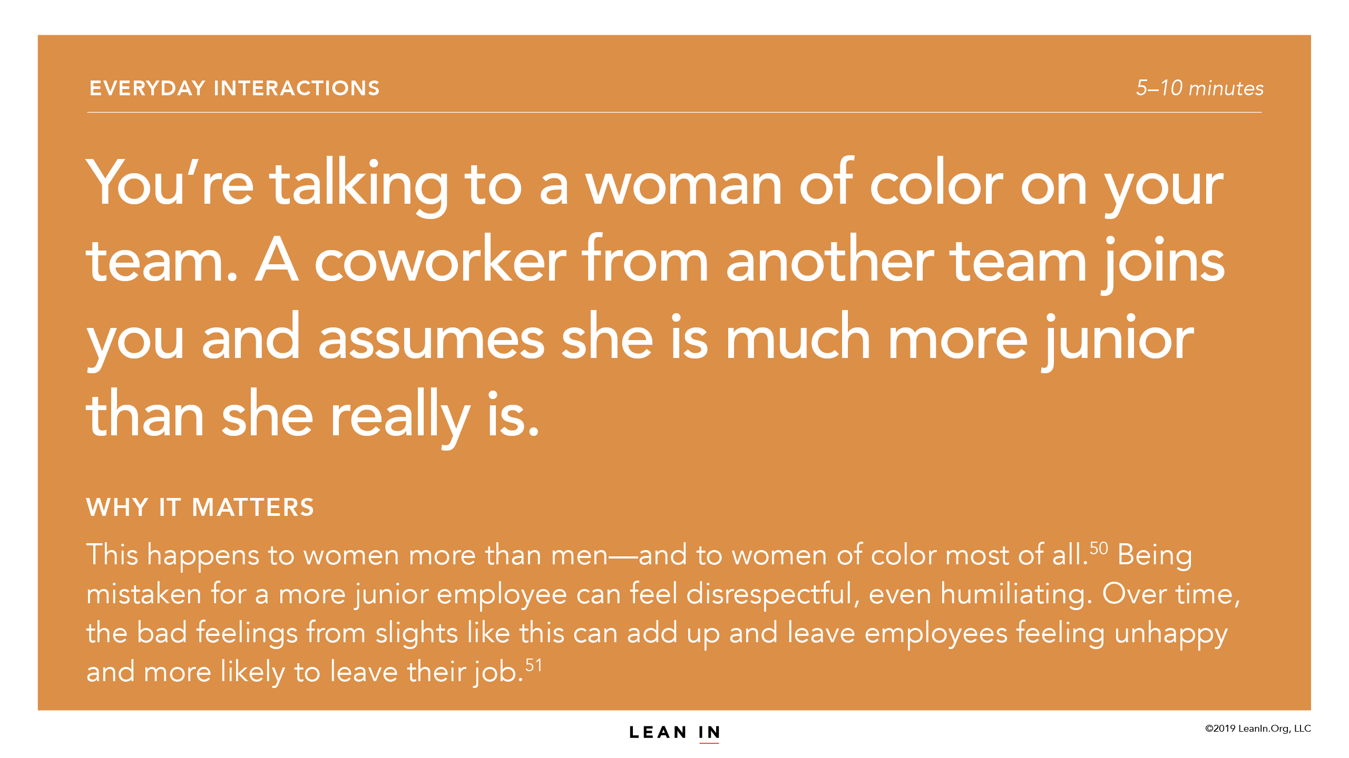

Slide 55
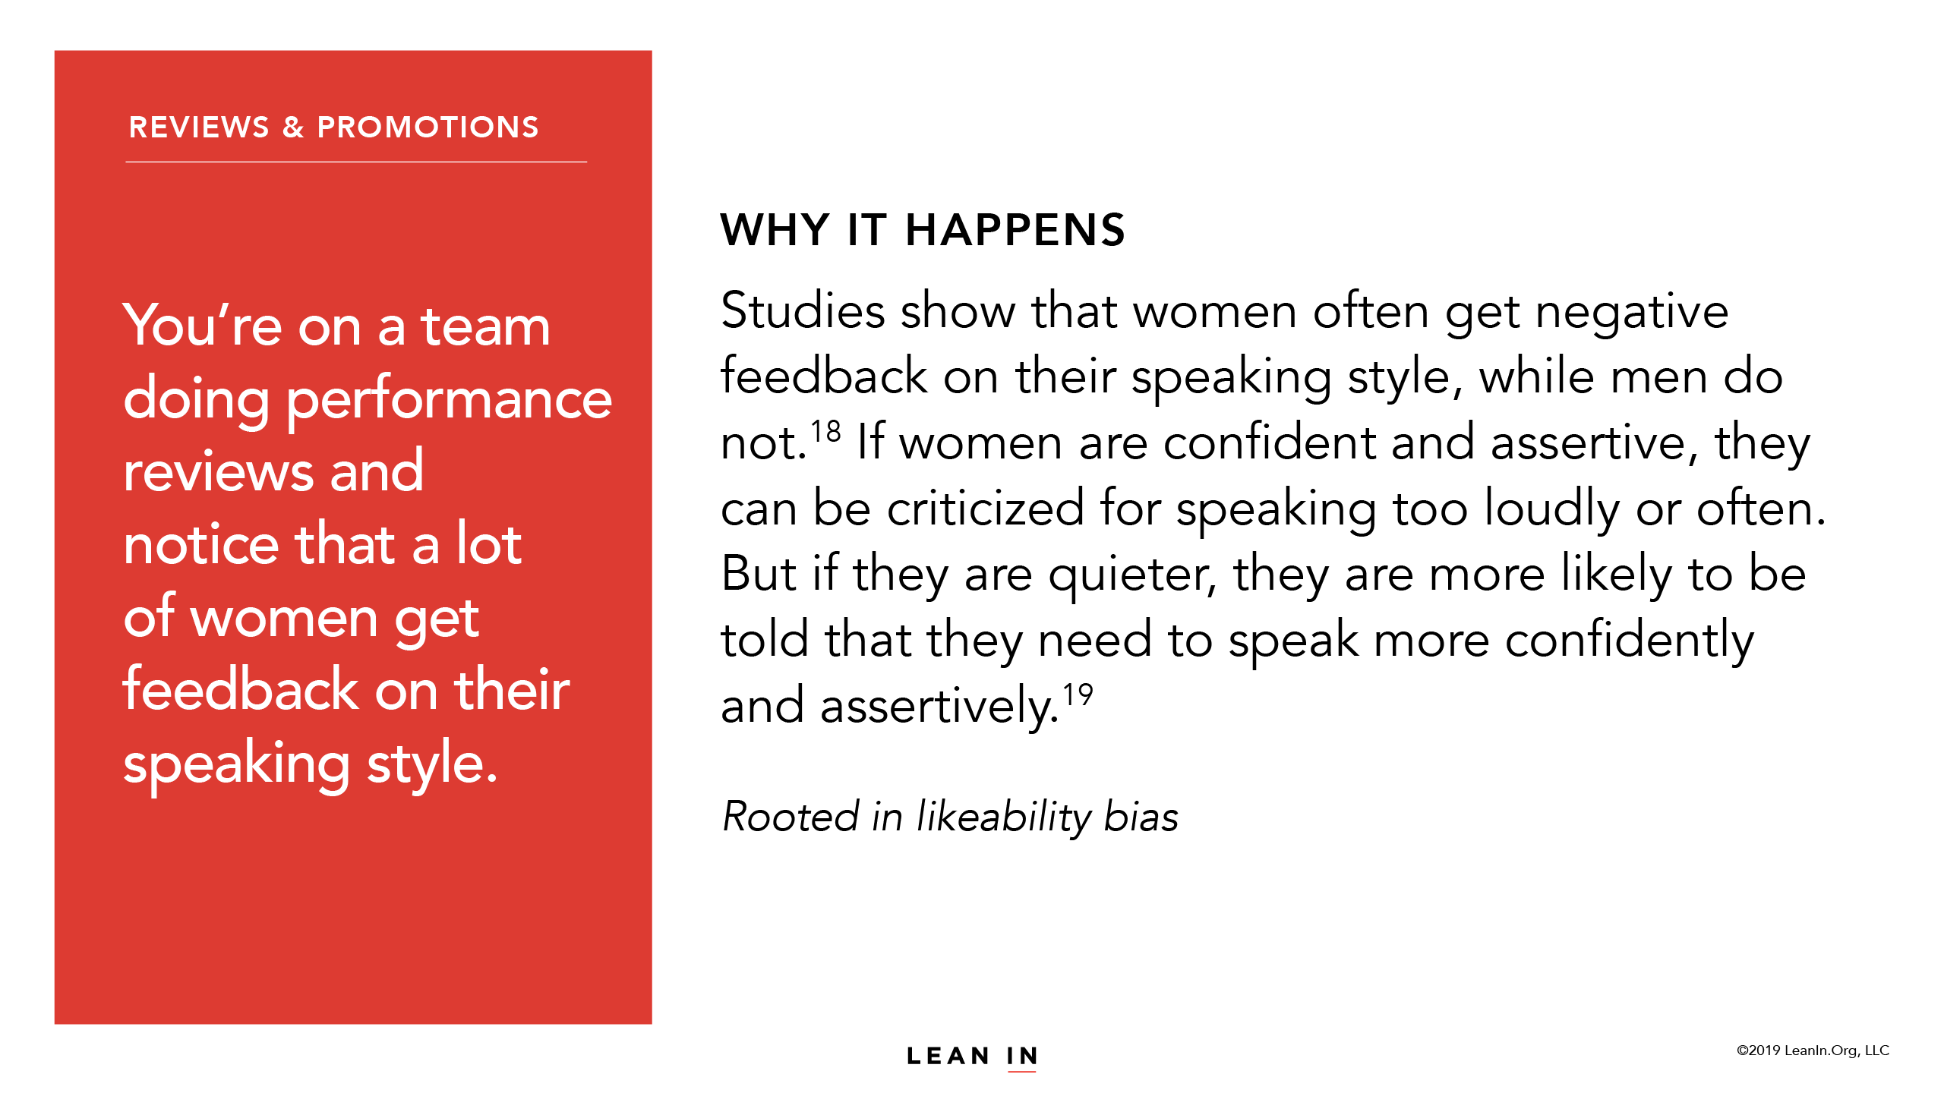

Slide 61
LEARN MORE AT
leanin.org

