Slide 1
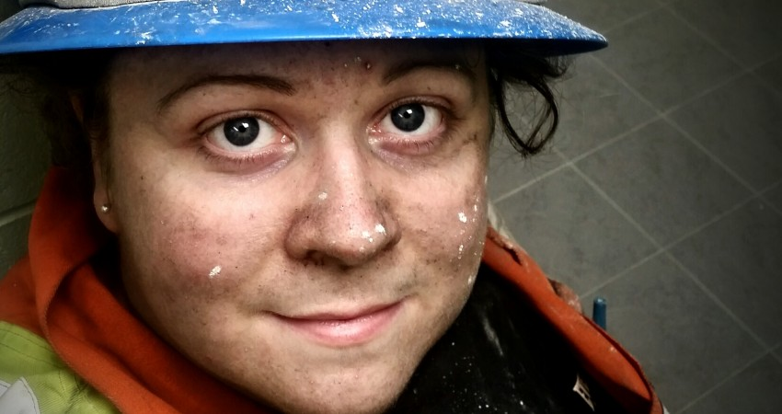
LINKEDIN DO’S & DONT’S
What does a good LinkedIn profile look like?
IWiM Impact and Influence photo competition 2017 grand prize winner Elsa Nielsen, a jackleg miner at Goldcorp – Hoyle Pond Mine, Canada whose image “They thought I couldn’t do it” demonstrates a woman’s strength, tenacity and determination to achieve against all odds.

Slide 2
A FEW FACTS
Lisa Finnegan, Senior HR Director EMEA & LATAM, LinkedIn
“ Value your human skills & stop calling them soft skills” – empathy, leadership & people management are essential
LinkedIn has 630m individual members globally, 26m companies, 20m jobs, 50,000 skills, 60,000 schools
Men and women look at job market differently
Gender parity across EMEA is number 1 priority for businesses
Women in STEM rising with exception of computer science leading to a pronounced gap in AI
52% of women on LI have a university degree
33% of women on LI work in STEM, in life sciences up to 62%
HR, people managers and marketing job categories in highest demand → where soft skills are essential
Recruiters 13% less likely to open a female profile on LI
If a woman applies she is 16% + likely to be successful
Women apply less

Slide 3
TIPS to improve your profile
Custom URL
Great photo
Use summary
Highlight Numbers & achievements
Get personal / I statements
Multimedia
Avoid jargon & acronyms
Have at least 50 connections
Write a great headline
Make sure people can find you
WAvoid jargon & acronyms
Avoid jargon & acronyms

Slide 4
HEADLINE
How to nail the one sentence that makes or breaks your LinkedIn profile
There are many sections on the LinkedIn profile but the one sentence that can really make or break it is the headline, which is the line underneath your profile picture and name.
Example
Many people use the headline incorrectly, and it’s not all their fault because LinkedIn doesn’t give much guidance on how to use it wisely.
One common mistake people make with the LinkedIn headline is just putting their functional job title in that section, for example, “Project Manager at XYZ Company” or “SVP, Marketing at ABC Company”.
Another common mistake, which is often made by people who are in transition, is putting something along the lines of “currently looking for new opportunities” as their headline.
There are 2 things wrong with doing this:
1. It doesn’t show what you’re good at, what it is you do or which industry you have experience in.
2. LinkedIn works as an algorithm. So, recruiters and hiring managers, for example, will use keywords to look for candidates. Words or phrases such as, “looking for next opportunity” are not what they are searching for and will not help your visibility.

Slide 5
HEADLINE
Action / Exercise
Go to your LinkedIn profile and find your headline. Then answer these 3 questions:
1. What is your unique selling proposition? What is it that you’re good at?
2. What are a few keywords that describe you? (Keywords may be specific to your industry or role)
3. What kind of industry do you have experience in?
Once you answer these 3 questions, combine them and recreate your headline.
Note that the limit for your LinkedIn headline is 120 characters, so pick out what’s most important for you to share from the answers to these three questions.

Slide 6
EXAMPLES
Wordsmith with proven ability to translate business objectives into communications strategies and tactics
Organizational Psychologist - Diversity & Inclusion. Human Resources; Mentoring & Coaching.
Alejandra
Independent board director specialising in business transformation and digital change
Ngonzi
QUALITY AND QUANTITY CONTROL MANAGER WORKING AS PRODUCTION MANAGER, GEOLOGY.
Author - Coach - Mentor

Slide 7
ADDITIONAL EXAMPLES
Chief Exec. Hampton-Alexander Review, NED Financial Services, RemComm.Chair & former FTSE100 Exec. in Oil& Gas/Energy.
Director D&I and Talent at Transport for London where we believe London is open for all /
Chief People Officer at Transport for London, keeping London moving, working and growing
Shareholder, white collar defence & special investigations, at Greenberg Traurig, LLP
Head of Diversity and Inclusion, EMEA at BNY Mellon, FT Top 10 Future Leaders
promote value-creative cultures (#performance) & prevent value-destructive events (#conformance & #protection) in mining.
PMP-certified project manager - Known for successfully leading multi-million dollar projects in developing countries.

Slide 8
JOB seeking TIPS
Use Your Target Job Descriptions to Your Advantage
Include a job description even if unemployed
Add multimedia to work experience section
Fill in text for each role
Keep your job search discreet
Use LinkedIn jobs platform
Make sure people can find you

Slide 9
How to
Update your Status
Become an author
Add your blog
LinkedIn groups

